Slide 1
CSS3

Slide 2

History of CSS
CSS was first proposed by Hakon Wium Lie on October 10, 1994. At the time, Lie was working with Tim Berners-Lee (father of Html) at CERN. Hakon wium lie is know as father of CSS.
CSS was proposed in 1994 as a web styling language, to solve some of the problems of Html 4. There were other styling languages proposed at this time, such as Style Sheets for Html and JSSS but CSS won.

Slide 3
What is CSS?
CSS stands for Cascading Style Sheets.
It is a style sheet language which is used to describe the look
and formatting of a document written in markup language.
It is generally used with HTML to change the style of web
pages and user interfaces

Slide 4


CSS Vs HTML
The Difference Between CSS and HTML.
CSS = CSS is mainly for presentation and design.
HTML = HTML is for content and web page structure. And it is building block of web page.
HTML
CSS

Slide 5
Syntax
Selector
body{
color : blue ;
}
Property Value

Slide 6
Ways to add CSS
There are three ways to add css to HTML
Inline Styles
Head Styles / Internal Styles
External Styles
Inline Styles
Inline CSS is used to apply CSS on a single line or element.
For example:
<p style="color : blue">Hello CSS</p>

Slide 7
Internal CSS
Internal CSS is used to apply CSS on a single document or page. It can affect all the elements of the page.
It is written inside the style tag within head section of html.
For example:
<style>
p{color:blue}
</style>

Slide 8
External CSS
External CSS is used to apply CSS on multiple pages or all pages. Here, we write all the CSS code in a css file.
Its extension must be .css for example style.css.
For example:
p{
color:blue;
}
You need to link this style.css file to your html pages like this:
<link rel="stylesheet" type="text/css" href="style.css">

Slide 9
CSS Selectors
Element Selector
Attribute Selector
Class Selector(.)
Id Selector(#)
Pseudo Classes

Slide 10
CSS Background
CSS background property is used to define the background effects on element.
There are 5 CSS background properties that affects the HTML elements:
1). background-color
2). background-image: url(‘’)
3). background-repeat
4). background-attachment
5). background-position

Slide 11
Border
The CSS border properties are use to specify the style, color and size of the border of an element.
The CSS border properties are given below
1. border-style
2. border-color
3. border-width
4. border-radius ==(%)

Slide 12
Display
CSS display is the most important property of CSS which is used to control the layout of the element. It specifies how the element is displayed.
There are following CSS display values which are commonly used.
1) display: inline;
2) display: inline-block;
3) display: block;
4) display: run-in;
5) display: none;

Slide 13
Fonts
CSS Font property is used to control the look of texts. By the use of CSS font property you can change the text size, color, style and more
These are some important font attributes
1) CSS Font color: This property is used to change the
color of the text. (standalone attribute)
2) CSS Font family: This property is used to change the face of the font.
3) CSS Font size: This property is used to increase or decrease
the size of the font.(px)
4) CSS Font style: This property is used to make the font bold, italic or oblique.
5) CSS Font variant: This property creates a small-caps effect.
6) CSS Font weight: This property is used to increase or
decrease the boldness and lightness of the font.

Slide 14
Text
List of Text properties:
Text Color
Text Alignment
Text Decorator
Text Transformation
Letter Spacing
Word Spacing
Text Direction
Text Overflow
Text Shadow

Slide 15
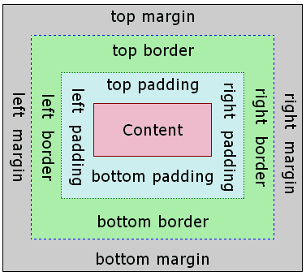
CSS Box Model

Slide 16
Transitions
CSS transitions allows you to change property values smoothly, over a given duration
List of transition properties
transition
transition-delay
transition-duration
transition-property
transition-timing-function

Slide 17
2D and 3D Transforms
CSS transforms allow you to move, rotate, scale, and skew elements
2D transformation methods:
translate()
rotate()
scaleX()
scaleY()
scale()
skewX()
skewY()
skew()

Slide 18
Gradient
CSS gradients let you display smooth transitions between two
or more specified colors.
CSS defines two types of gradients:
1) Linear Gradients (goes down/up/left/right/diagonally)
2) Radial Gradients (defined by their center)

